Slide 1
Application Delivery Fundamentals 2.0 B: Java
Micro Service

Slide 2
Micro Service
Goals
Independent deployment of components
Independent scaling of components
Independent implementation stacks for each component
Easy self-serve deployments of components
Repeatable deployments of components (external configuration management)
Deployments without service interruptions

Slide 3
Micro Service
Goals
Protection of system availability from individual Instance failure
Automatic replacement of component instances when they fail (self-healing)
Easy scaling of components by adjusting a simple parameter value
Canary testing
"Red/black" or "blue/green" deployments
Instant reversal of new revision deployments

Slide 4
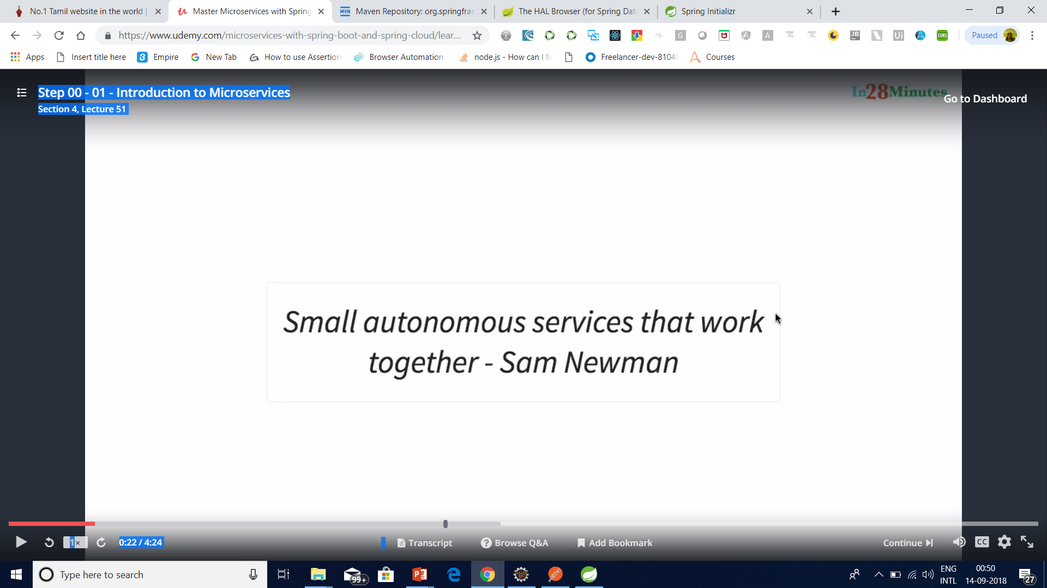
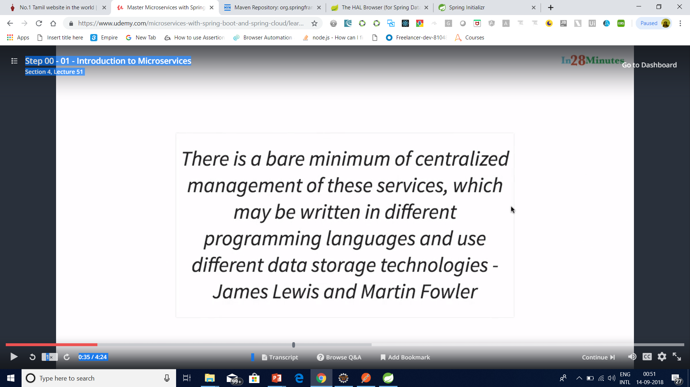
Micro Service

Slide 5

Micro Service

Slide 6
Micro Service

Slide 7

Micro Service

Slide 8

Micro Service

Slide 9
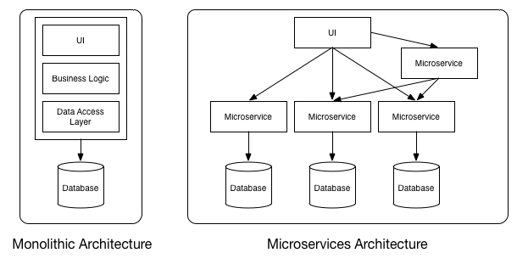
MicroService

Slide 10
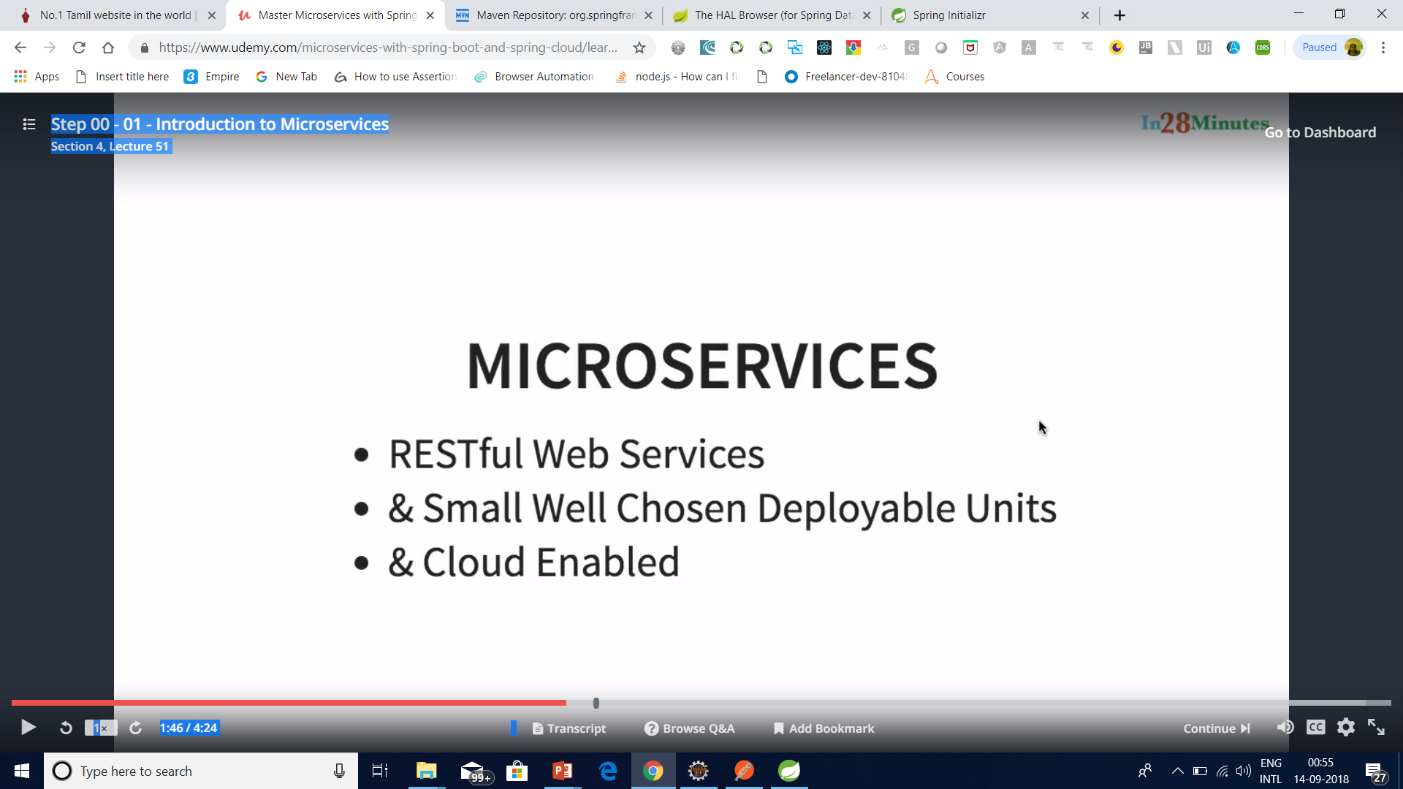
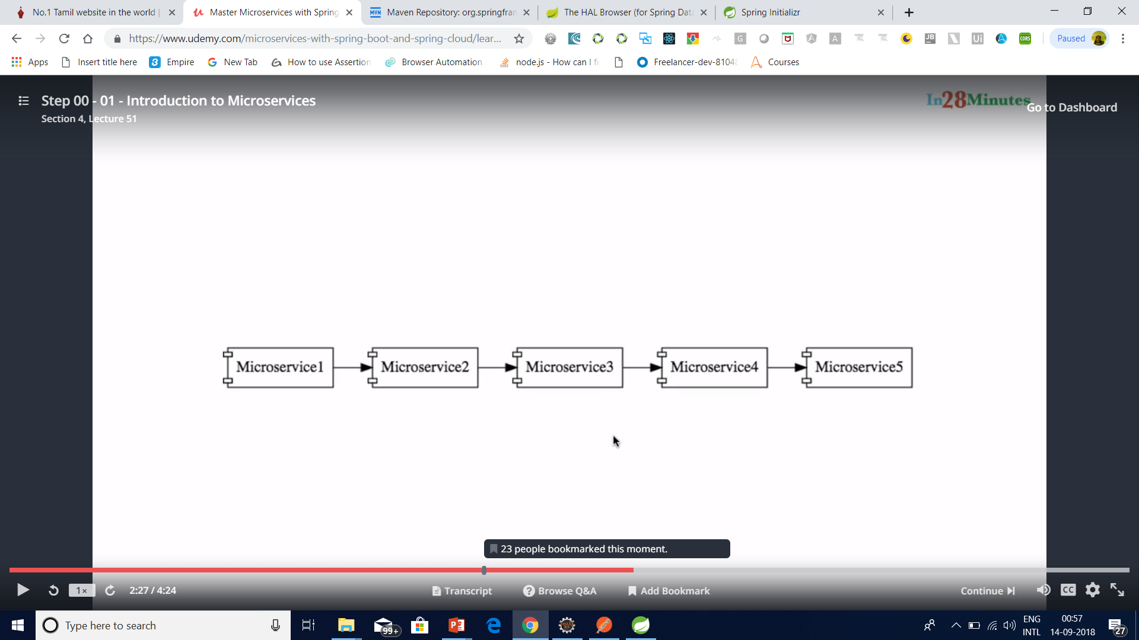
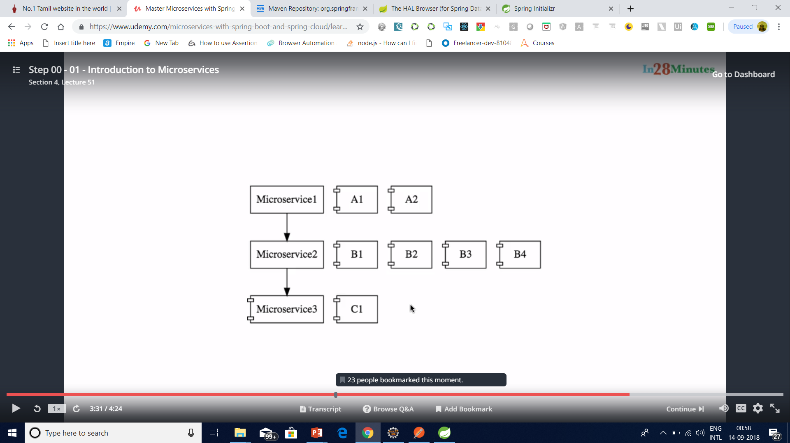
Micro Service

Slide 11
What is Microservices
Microservices is a variant of the service-oriented architecture (SOA) architectural style that structures an application as a collection of loosely coupled services.

Slide 12
What is Microservices
In a microservices architecture, services should be fine-grained and the protocols should be lightweight.
The benefit of decomposing an application into different smaller services is that it improves modularity and makes the application easier to understand, develop and test.

Slide 13
What is Microservices
It also parallelizes development by enabling small autonomous teams to develop, deploy and scale their respective services independently.

Slide 14
What are the Benefits of Microservices?
Smaller applications are not dependent on the same coding language, the developers can use the programming language that they are most familiar with.
That helps developers come up with a program faster with lower costs and fewer bugs.
The agility and low costs can also come from being able to reuse these smaller programs on other projects, making it more efficient.

Slide 15
Principles of Microservices
Single responsibility principle
The single responsibility principle is one of the principles defined as part of the SOLID design pattern. It implies that a unit, either a class, a function, or a microservice, should have one and only one responsibility.
At no point of time, one microservice should have more than one responsibility.

Slide 16
Principles of Microservices
Built around business capabilities
Microservices should focus on certain business function and ensure that it helps in getting things done. A microservice shall never restrict itself from adopting appropriate technology stack or backend database storage which is most suitable for solving the business purpose.
This is often the constraint when we design monolithic applications where we try to solve multiple business solutions with some compromises in some areas. Microservices enable you to choose whats best for the problem in hand.

Slide 17
Principles of Microservices
You build it, you own it!
Another important aspect of such design is related to responsibilities pre-and-post development. In large organization, usually one team develops the app location, and after some knowledge transfer sessions it hand over the project to maintenance team. In microservices, the team which build the service – owns it, and is responsible for maintaining it in future.

Slide 18
Principles of Microservices
Infrastructure Automation
Preparing and building infrastructure for microservices is another very important need. A service shall be independently deployableand shall bundle all dependencies, including library dependencies, and even execution environments such as web servers and containers or virtual machines that abstract physical resources.
One of the major differences between microservices and SOA is in their level of autonomy. While most SOA implementations provide service-level abstraction, microservices go further and abstract the realization and execution environment.

Slide 19
Principles of Microservices
Infrastructure Automation
In traditional application developments, we build a WAR or an EAR, then deploy it into a JEE application server, such as with JBoss, WebLogic, WebSphere, and so on. We may deploy multiple applications into the same JEE container. In ideal scenario, in the microservices approach, each microservice will be built as a fat Jar, embedding all dependencies and run as a standalone Java process.

Slide 20
Principles of Microservices
Design for Failure
A microservice shall be designed with failure cases in mind. What if the service fails, or go down for some time. These are very important questions and must be solved before actual coding starts – to clearly estimate how service failures will affect the user experience.
Fail fast is another concept used to build fault-tolerant, resilient systems. This philosophy advocates systems that expect failures versus building systems that never fail. Since services can fail at any time, it’s important to be able to detect the failures quickly and, if possible, automatically restore service.

Slide 21
Principles of Microservices
Design for Failure
Microservice applications put a lot of emphasis on real-time monitoring of the application, checking both architectural elements (how many requests per second is the database getting) and business relevant metrics (such as how many orders per minute are received). Semantic monitoring can provide an early warning system of something going wrong that triggers development teams to follow up and investigate.

Slide 22
Benefits of Microservices
With microservices, architects and developers can choose fit for purpose architectures and technologies for each microservice (polyglot architecture). This gives the flexibility to design better-fit solutions in a more cost-effective way.
As services are fairly simple and smaller in size, enterprises can afford to experiment new processes, algorithms, business logic, and so on. It enables enterprises to do disruptive innovation by offering the ability to experiment and fail fast.

Slide 23
Benefits of Microservices
Microservices enable to implement selective scalability i.e. each service could be independently scaled up or down and cost of scaling is comparatively less than monolithic approach.
Microservices are self-contained, independent deployment modules enabling the substitution of one microservice with another similar microservice, when second one is not performing as per our need. It helps in taking right buy-versus-build decisions which are often the challenge for many enterprises.

Slide 24
Benefits of Microservices
Microservices help us build systems that are organic in nature(Organic systems are systems that grow laterally over a period of time by adding more and more functions to it). Because microservices are all about independently manageable services – it enable to add more and more services as the need arises with minimal impact on the existing services.
Technology changes are one of the barriers in software development. With microservices, it is possible to change or upgrade technology for each service individually rather than upgrading an entire application.

Slide 25
Benefits of Microservices
As microservices package the service runtime environment along with the service itself, this enables having multiple versions of the service to coexist in the same environment.
And finally, microservices also enable smaller, focused agile teams for development. Teams will be organized based on the boundaries of microservices.

Slide 26
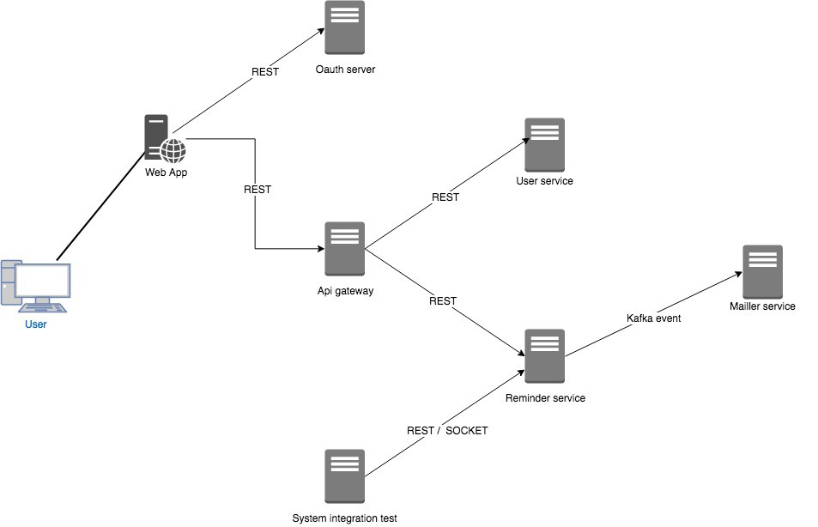

Slide 27
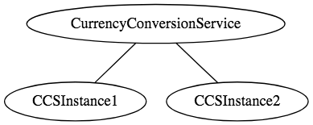
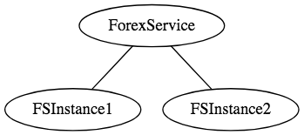
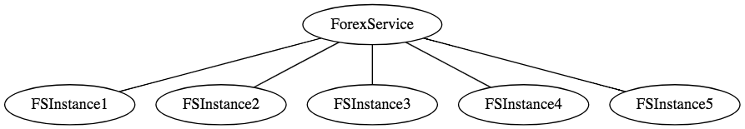
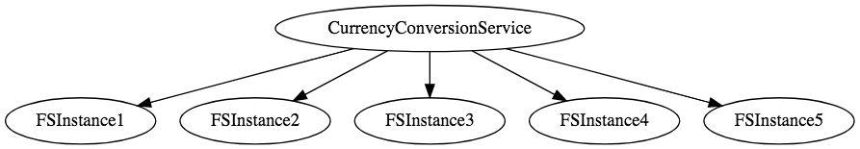

Slide 28
Examples of Microservices Frameworks for Java
There are several microservices frameworks that you can use for developing for Java. Some of these are:
Spring Boot. This is probably the best Java microservices framework that works on top of languages for Inversion of Control, Aspect Oriented Programming, and others.
Jersey. This open source framework supports JAX-RS APIs in Java is very easy to use.
Swagger. Helps you in documenting API as well as gives you a development portal, which allows users to test your APIs.

Slide 29
Challenges with Microservice Architectures
Quick Setup needed : You cannot spend a month setting up each microservice. You should be able to create microservices quickly.
Automation : Because there are a number of smaller components instead of a monolith, you need to automate everything - Builds, Deployment, Monitoring etc.
Visibility : You now have a number of smaller components to deploy and maintain. Maybe 100 or maybe 1000 components. You should be able to monitor and identify problems automatically. You need great visibility around all the components.

Slide 30
Challenges with Microservice Architectures
Bounded Context : Deciding the boundaries of a microservice is not an easy task. Bounded Contexts from Domain Driven Design is a good starting point. Your understanding of the domain evolves over a period of time. You need to ensure that the microservice boundaries evolve.
Configuration Management : You need to maintain configurations for hundreds of components across environments. You would need a Configuration Management solution
Dynamic Scale Up and Scale Down : The advantages of microservices will only be realized if your applications can scaled up and down easily in the cloud.
Pack of Cards : If a microservice at the bottom of the call chain fails, it can have knock on effects on all other microservices. Microservices should be fault tolerant by Design.

Slide 31
Challenges with Microservice Architectures
Debugging : When there is a problem that needs investigation, you might need to look into multiple services across different components. Centralized Logging and Dashboards are essential to make it easy to debug problems.
Consistency : You cannot have a wide range of tools solving the same problem. While it is important to foster innovation, it is also important to have some decentralized governance around the languages, platforms, technology and tools used for implementing/deploying/monitoring microservices.

Slide 32
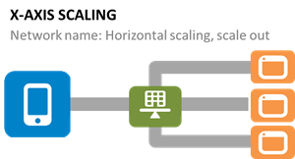
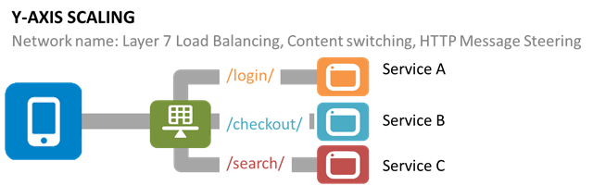
Scaling Challenge

Slide 33
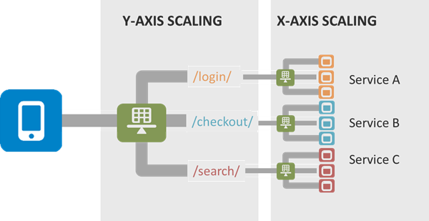
Scaling Challenge

Slide 34
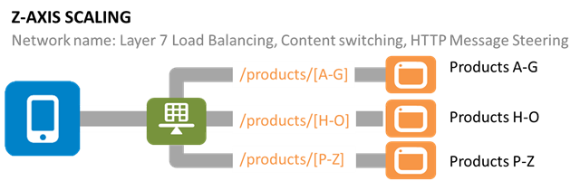
Scaling Challenge

Slide 35
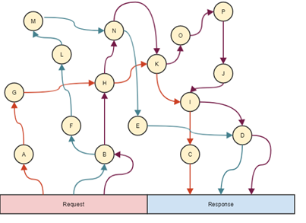
Saga Pattern

Slide 36
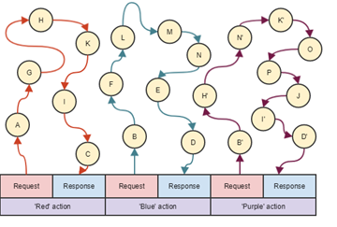
Saga Pattern

Slide 37
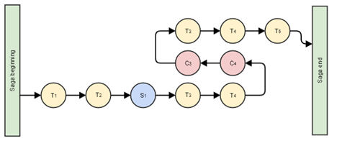
Saga Pattern

Slide 38
Proposed Solutions to Handle Challenges
1. Data Synchronization — We have event sourcing architecture to address this issue using the async messaging platform. The saga design pattern can address this challenge.
2. Security — An API Gateway can solve these challenges. Kong is very popular and is open-source, and is being used by many companies in production. Custom solutions can also be developed for API security using JWT token, Spring Security, and Netflix Zuul/ Zuul2. There are enterprise solutions available, too, like Apigee and Okta (2-step authentication). Openshift is used for public cloud security for its top features, like Red Hat Linux Kernel-based security and namespace-based app-to-app security.
3. Versioning — This will be taken care of by API registry and discovery APIs using the dynamic Swagger API, which can be updated dynamically and shared with consumers on the server.
4. Discovery — This will be addressed by API discovery tools like Kubernetes and OpenShift. It can also be done using Netflix Eureka at the code level. However, doing it in with the orchestration layer will be better and can be managed by these tools rather doing and maintaining it through code and configuration.

Slide 39
Proposed Solutions to Handle Challenges
5. Data Staleness — The database should be always updated to give recent data. The API will fetch data from the recent and updated database. A timestamp entry can also be added with each record in the database to check and verify the recent data. Caching can be used and customized with an acceptable eviction policy based on business requirements.
6. Debugging and Logging — There are multiple solutions for this. Externalized logging can be used by pushing log messages to an async messaging platform like Kafka, Google PubSub, etc. A correlation ID can be provided by the client in the header to REST APIs to track the relevant logs across all the pods/Docker containers. Also, local debugging can be done individually on each microservice using the IDE or checking the logs.
7. Testing — This issue can be addressed with unit testing by mocking REST APIs or integrated/dependent APIs which are not available for testing using WireMock, BDD, Cucumber, integration testing, performance testing using JMeter, and any good profiling tool like Jprofiler, DynaTrace, YourToolKit, VisualVM, etc.

Slide 40
Proposed Solutions to Handle Challenges
8. Monitoring — Monitoring can be done using open-source tools like Prometheus in combination with Grafana by creating gauge and matrices, Kubernetes/OpensShift, Influx DB, Apigee, combined with Grafana, and Graphite.
9. DevOps Support — Microservices deployment and support-related challenges can be addressed using state-of-the-art DevOps tools like GCP, Kubernetes, and OpenShift with Jenkins.
10. Fault Tolerance — Netflix Hystrix can be used to break the circuit if there is no response from the API for the given SLA/ETA.

Slide 41
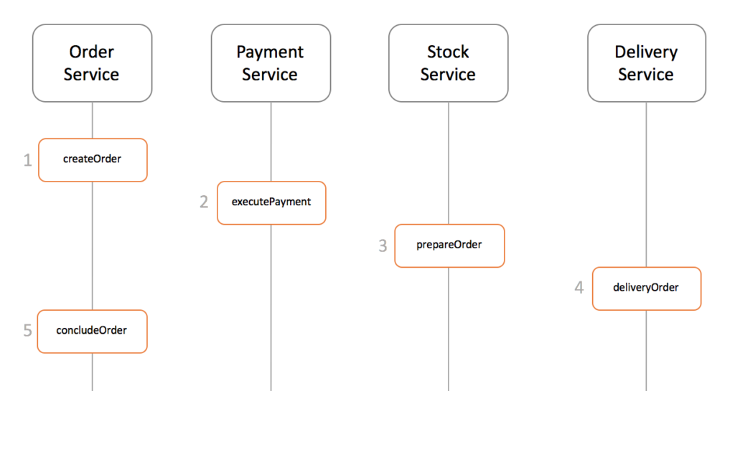
Saga Design Pattern

Slide 42
Saga Design Pattern
Events/Choreography: When there is no central coordination, each service produces and listen to other service’s events and decides if an action should be taken or not.
Command/Orchestration: when a coordinator service is responsible for centralizing the saga’s decision making and sequencing business logic

Slide 43
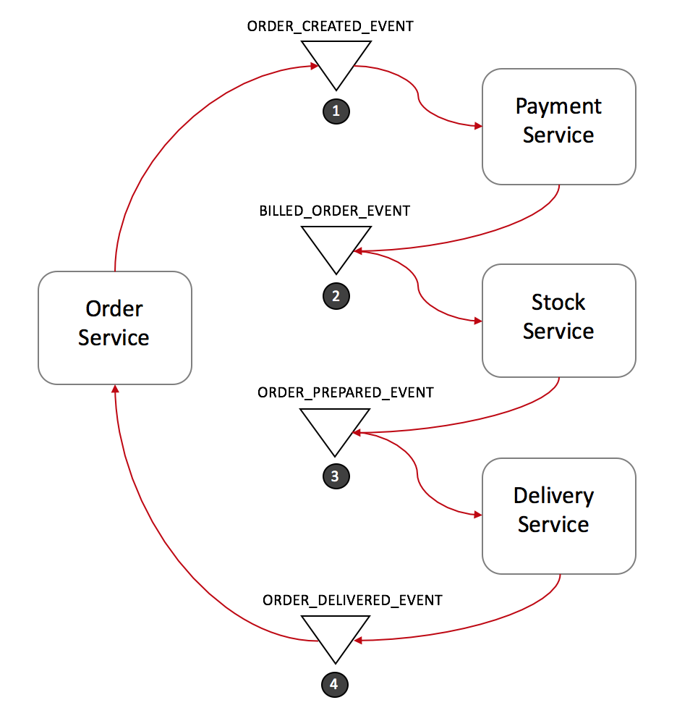
Event Choreography

Slide 44
Solutions to Challenges with Microservice Architectures
Spring Boot
Enable building production ready applications quickly
Provide non-functional features
embedded servers (easy deployment with containers)
metrics (monitoring)
health checks (monitoring)
externalized configuration

Slide 45
Solutions to Challenges with Microservice Architectures
Spring Cloud
Spring Cloud provides solutions to cloud enable your microservices.
It leverages and builds on top of some of the Cloud solutions opensourced by Netflix (Netflix OSS).

Slide 46
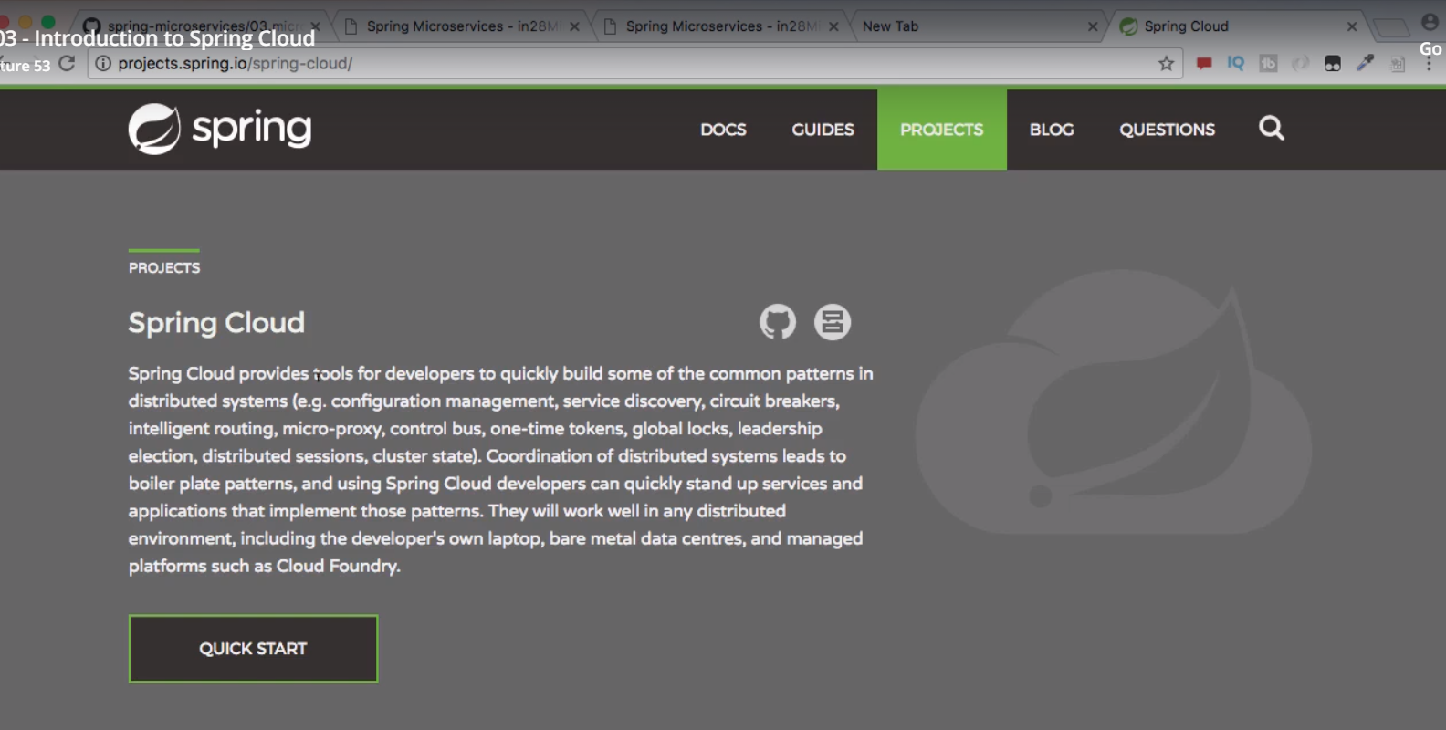
Spring Cloud

Slide 47
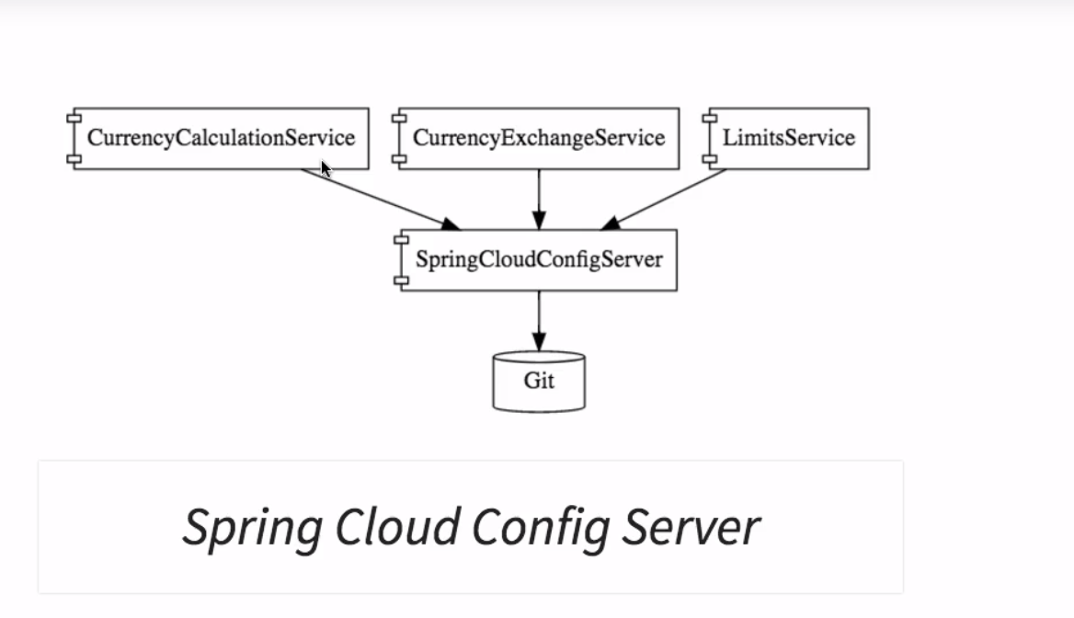
Spring Cloud

Slide 48
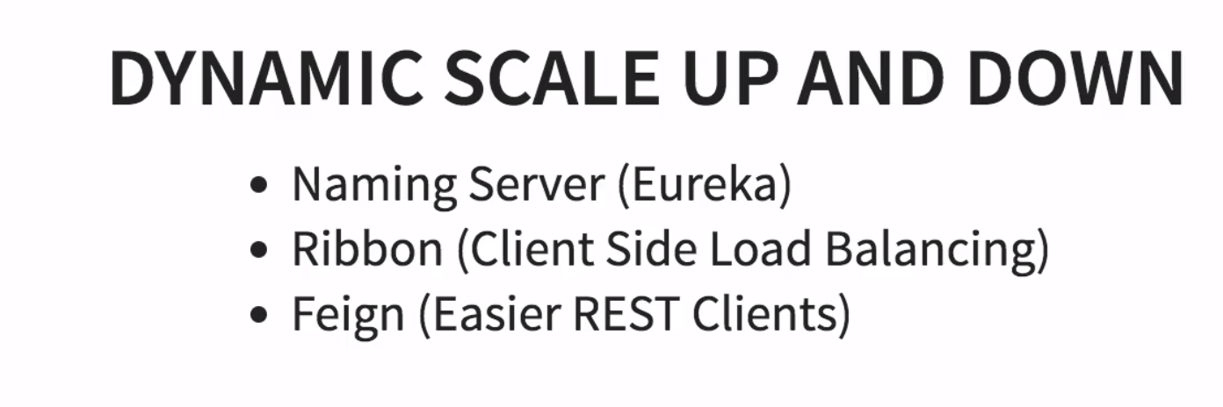
Spring Cloud

Slide 49
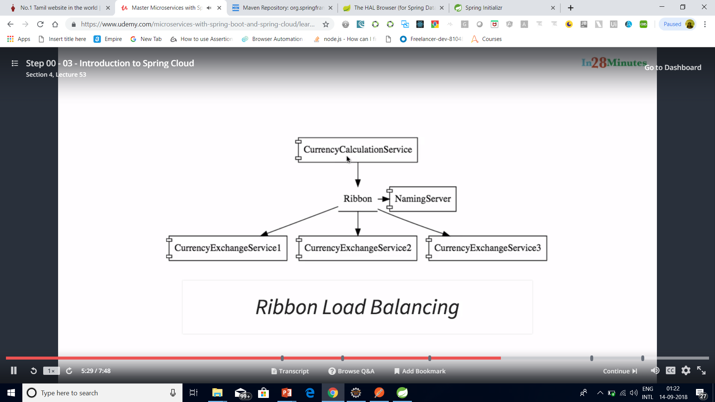
Spring Cloud

Slide 50
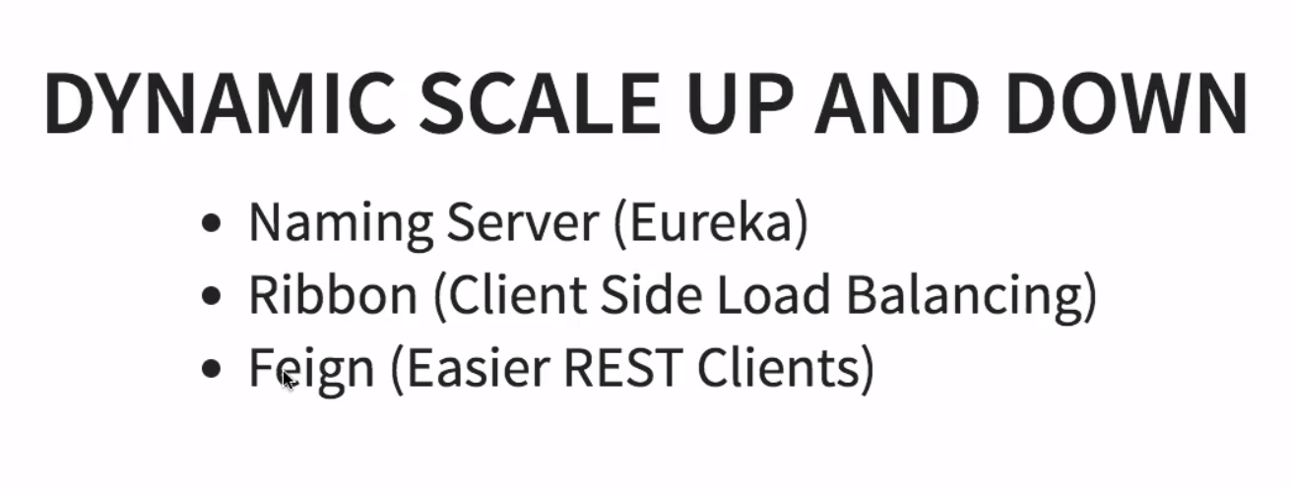
Spring Cloud

Slide 51
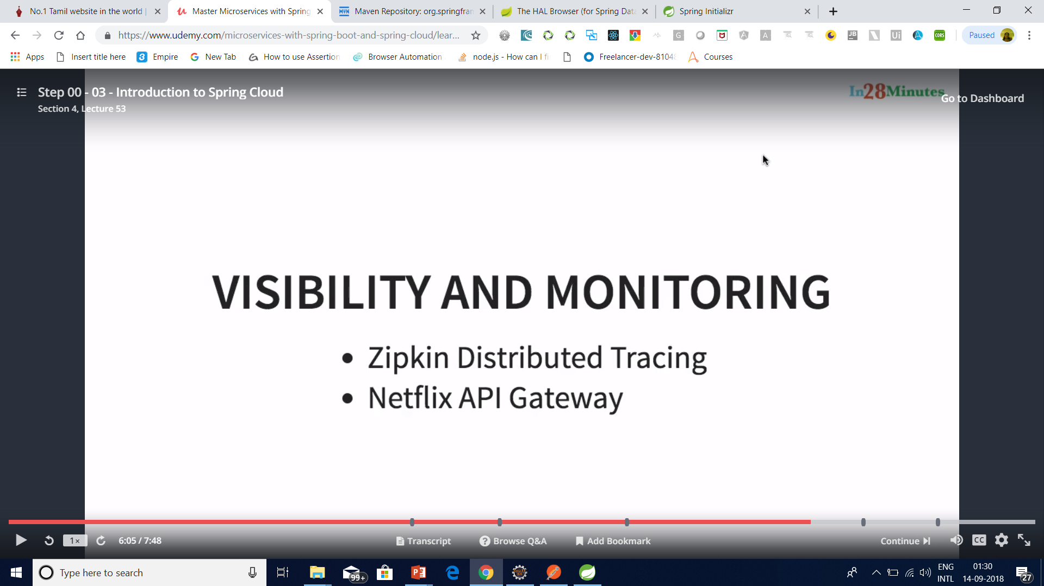
Spring Cloud

Slide 52
Important Spring Cloud Modules
Dynamic Scale Up and Down. Using a combination of
Naming Server (Eureka)
Ribbon (Client Side Load Balancing)
Feign (Easier REST Clients)
Visibility and Monitoring with
Zipkin Distributed Tracing
Netflix API Gateway
Configuration Management with
Spring Cloud Config Server
Fault Tolerance with
Hystrix

Slide 53
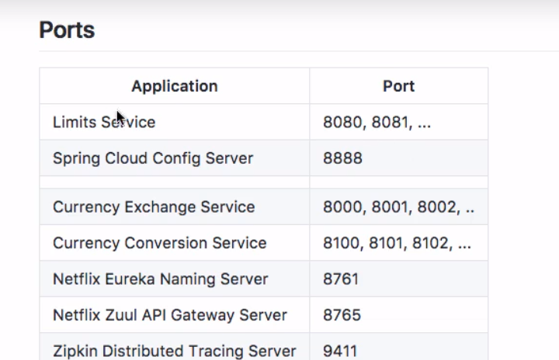
Standardized ports

Slide 54
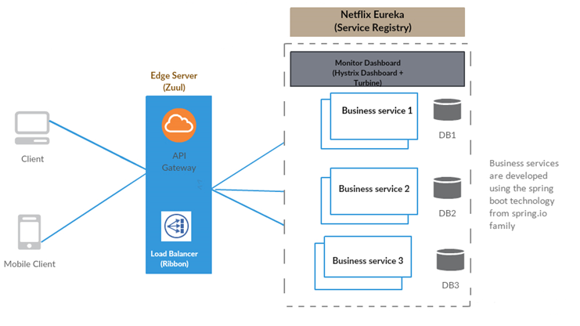

Slide 55
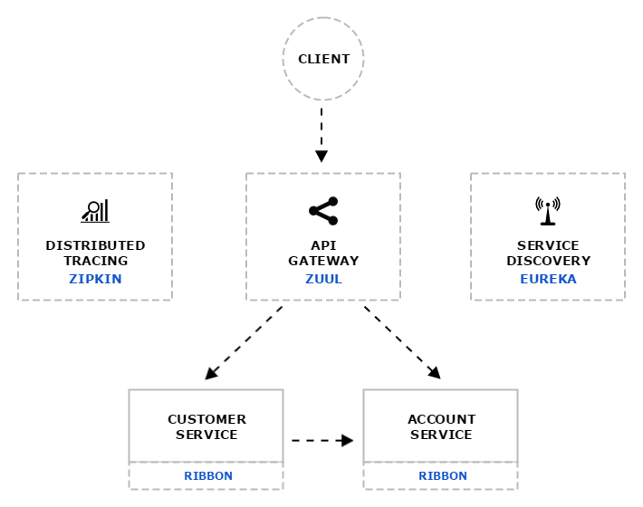
Distributed tracing system with request visualization.
Monitoring, routing and security
client side Load Balancers

Slide 56
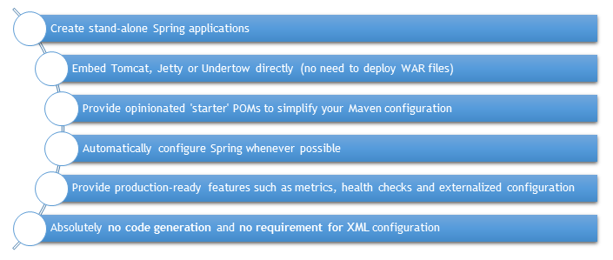
Spring Boot and Microservices

Slide 57
Why Eureka Server
In the distributed computing are there is a concept called ‘Service registration and discovery’ where one dedicated server is responsible to maintain the registry of all the Microservice that has been deployed and removed. This will act like a phone book of all other applications/microservices.

Slide 58
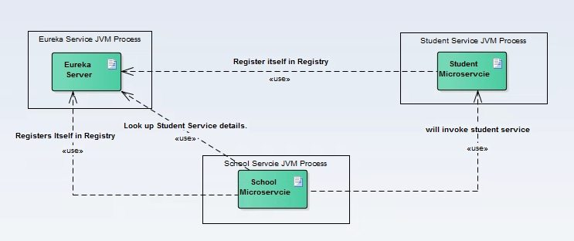
Spring Cloud Service Discovery with Netflix Eureka

Slide 59
Server Configuration
server:
port: ${PORT:8761} # Indicate the default PORT where this service will be started
eureka:
client:
registerWithEureka: false #telling the server not to register himself in the service registry
fetchRegistry: false
server:
waitTimeInMsWhenSyncEmpty: 0 #wait time for subsequent sync

Slide 60
Client Configuration
server:
port: 8098 #default port where the service will be started
eureka: #tells about the Eureka server details and its refresh time
instance:
leaseRenewalIntervalInSeconds: 1
leaseExpirationDurationInSeconds: 2
client:

Slide 61
Client Configuration
serviceUrl:
defaultZone: http://127.0.0.1:8761/eureka/
healthcheck:
enabled: true
lease:
duration: 5
spring:
application:
name: student-service #current service name to be used by the eureka server

Slide 62
Client Configuration
management:
security:
enabled: false #disable the spring security on the management endpoints like /env, /refresh etc.
logging:
level:
com.example.howtodoinjava: DEBUG

Slide 63
Consul Service Registration and Discovery Example
Consul provides multiple features like service discovery, configuration management, health checking and key-value store etc.

Slide 64
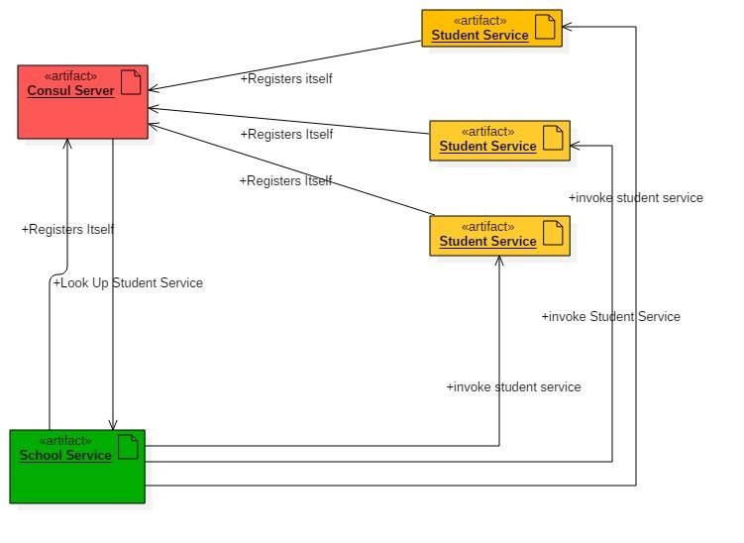
Consul Service Registration and Discovery Example
Consul Agent – running on localhost acting as discovery/registry server functionality.

Slide 65
Configuring Consul in Local workstation
Download from Consul portal. Choose particular package based on the operating System. Once downloaded the zip, we need to unzip it to desired place.
Start Consul Agent in local workstation – The Zip file that we have unzipped, has only one exe file called consul.exe. We will start a command prompt here and use below command to start the agent.
consul agent -server -bootstrap-expect=1 -data-dir=consul-data -ui -bind=192.168.6.1

Slide 66
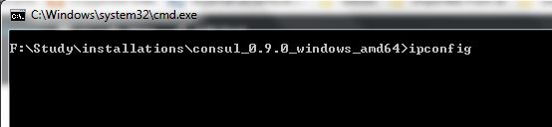
Configuring Consul in Local workstation
Make sure you enter the correct bind address, it would be different depending on the LAN settings. Do a ipconfig in command prompt to know your IpV4 address and use it here.

Slide 67
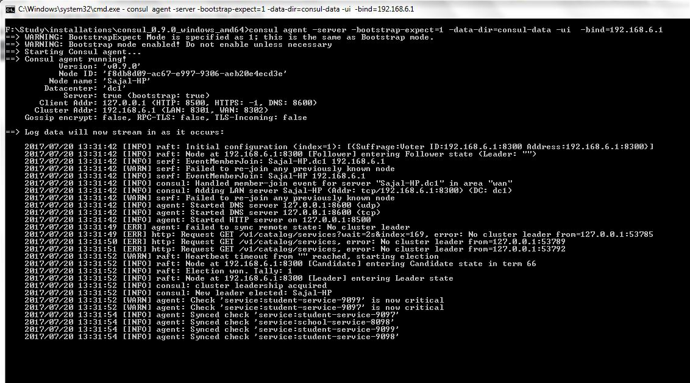
Configuring Consul in Local workstation

Slide 68
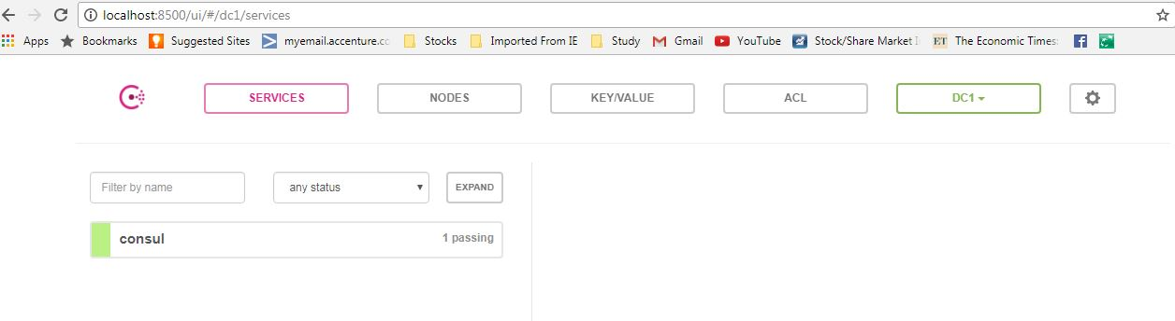
Configuring Consul in Local workstation
Test whether Consul Server is running – Consul runs on default port and once agent started successfully, browse http://localhost:8500/uiand you should see a console screen like –

Slide 69
Consul Client
Create Student Project
Create a Spring boot project from initializer portal with four dependencies i.e.
Actuator
Web
Rest Repositories
Consul Discovery

Slide 70
Service Configuration
server.port=9098 – will start the service in default 9098 port.
spring.application.name: student-service – will registers itself in consul server using student-service tag and also other services will lookup this service with this name itself.
management.security.enabled=false – is not actually required for this exercise, but it will disable spring security in the management endpoints provided by actuator module.

Slide 71
Hystrix Circuit Breaker Pattern – Spring Cloud
It is generally required to enable fault tolerance in the application where some underlying service is down/throwing error permanently, we need to fall back to different path of program execution automatically.
This is related to distributed computing style of Eco system using lots of underlying Microservices.
This is where circuit breaker pattern helps and Hystrix is an tool to build this circuit breaker.

Slide 72
What is Circuit Breaker Pattern?
If we design our systems on microservice based architecture, we will generally develop many Microservices and those will interact with each other heavily in achieving certain business goals.
Now, all of us can assume that this will give expected result if all the services are up and running and response time of each service is satisfactory.

Slide 73
What is Circuit Breaker Pattern?
Now what will happen if any service, of the current Eco system, has some issue and stopped servicing the requests.
It will result in timeouts/exception and the whole Eco system will get unstable due to this single point of failure.

Slide 74
What is Circuit Breaker Pattern?
Here circuit breaker pattern comes handy and it redirects traffic to a fall back path once it sees any such scenario.
Also it monitors the defective service closely and restore the traffic once the service came back to normalcy.

Slide 75
What is Circuit Breaker Pattern?
So circuit breaker is a kind of a wrapper of the method which is doing the service call and it monitors the service health and once it gets some issue, the circuit breaker trips and all further calls goto the circuit breaker fall back and finally restores automatically once the service came back !! That’s cool right?

Slide 76
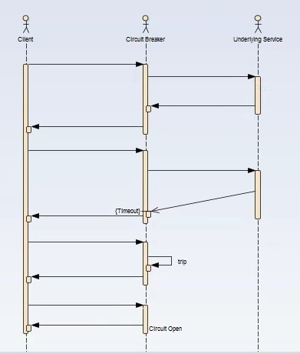
What is Circuit Breaker Pattern?

Slide 77
Hystrix Dashboard
http://localhost:9091/hystrix
http://localhost:9091/actuator/hystrix.stream – It’s a continuous stream that Hystrix generates. It is just a health check result along with all the service calls that are being monitored by Hystrix. Sample output will look like in browser –

Slide 78
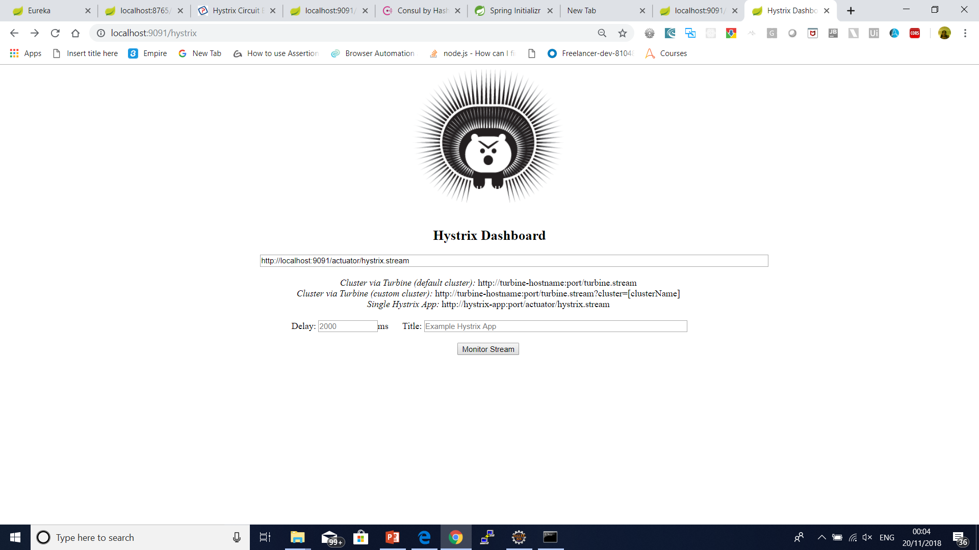

Slide 79
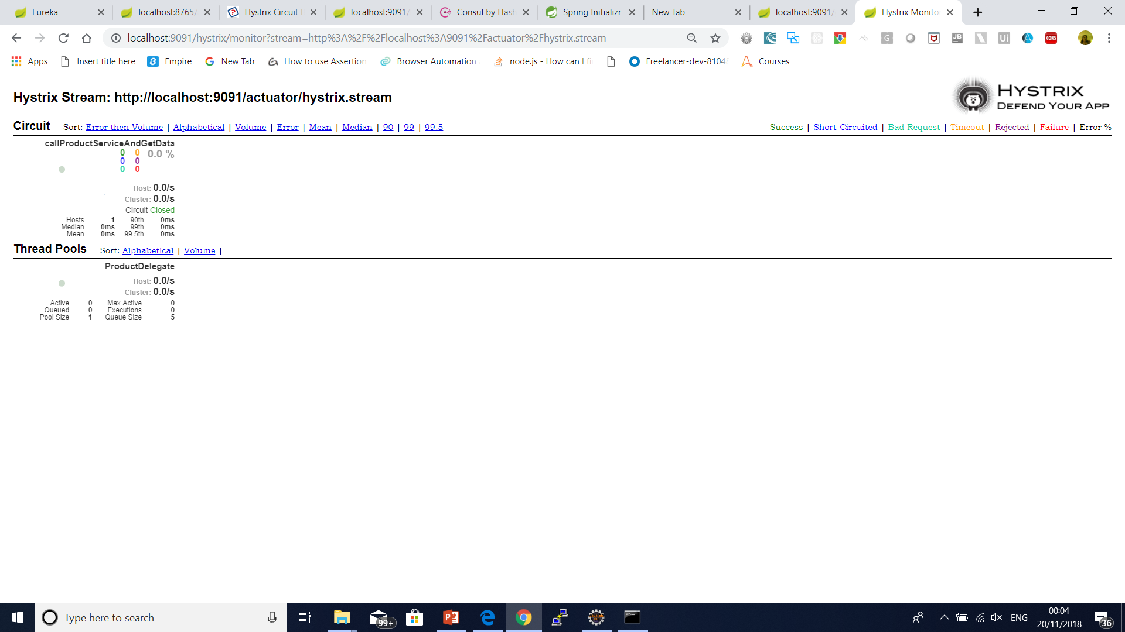

Slide 80
How to Deploy Spring Boot Application to Cloud Foundry Platform
Cloud Foundry is one of the Cloud Providers. It is a PaaS service where we can easily deploy and manage our applications and the Cloud Foundry will take care of the rest of the cloud based offerings like scalability, high availability etc.

Slide 81
What is Cloud Foundry
Cloud Foundry is an open-source platform as a service (PaaS) that provides you with a choice of clouds, developer frameworks, and application services.
It is open source and it is governed by the Cloud Foundry Foundation.
The original Cloud Foundry was developed by VMware and currently it is managed by Pivotal, a joint venture company by GE, EMC and VMware.

Slide 82
What is Cloud Foundry
Now since Cloud Foundry is open source product many popular organizations currently provides this platform separately and below are the list of current certified providers.
Pivotal Cloud Foundry
IBM Bluemix
HPE Helion Stackato 4.0
Atos Canopy
CenturyLink App Fog
GE Predix
Huawei FusionStage
SAP Cloud Platform
Swisscom Application Cloud

Slide 83
Cloud Foundry Installation for Windows
Download the CF Windows installer. It will prompt for the download. Save the zip file distribution.
Unpack the zip file to a suitable place in your workstation.
After successfully unzip operation, double cick on the cf CLI executable.
When prompted, click Install, then Close. Here are the sample steps for the same. This is very straight froward, you can select the default values.

Slide 84
Cloud Foundry Installation for Windows
Verify the installation by opening a terminal window and type cf. If your installation was successful, the cf CLI help listing appears. This indicates that you are ready to go with any cloud foundry platform from your local workstation.

Slide 85
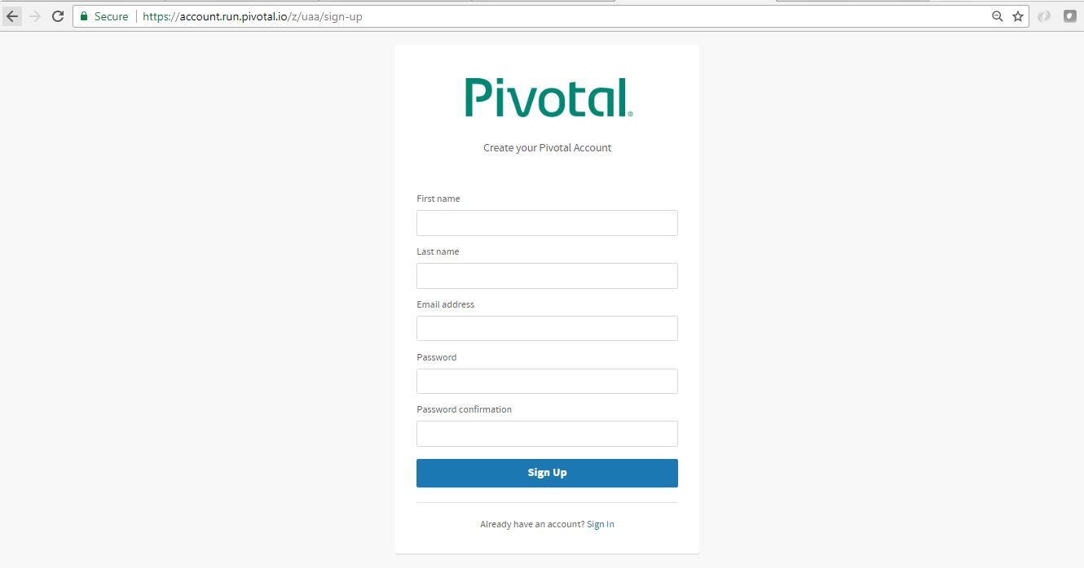
Setup PWS Console

Slide 86
Login and logout from PWS Console using CLI
Login to PWS – We will use cf login -a api.run.pivotal.io command to login to pivotal web service console from CLI tool that we have installed in our local workstation. It will logon the CLI tool to PWS platform so that we can deploy and manage our applications from our workstation. After giving command, it will ask for registered email and password and once provided successfully, it will logon to the platform.
Logout from PWS Console – We will use command cf logout to logout from the platform, once we have all the work done for that session.

Slide 87
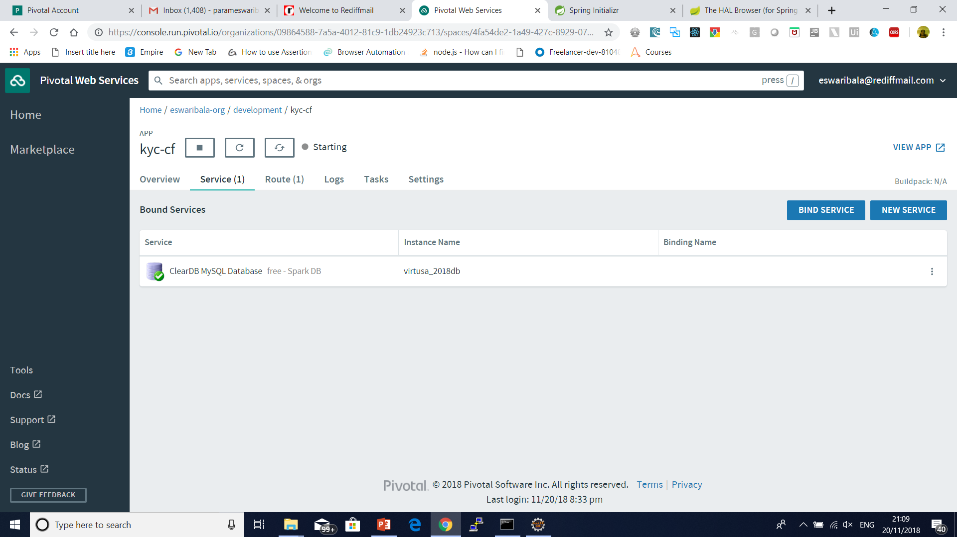
Create Database in cloud foundry

Slide 88
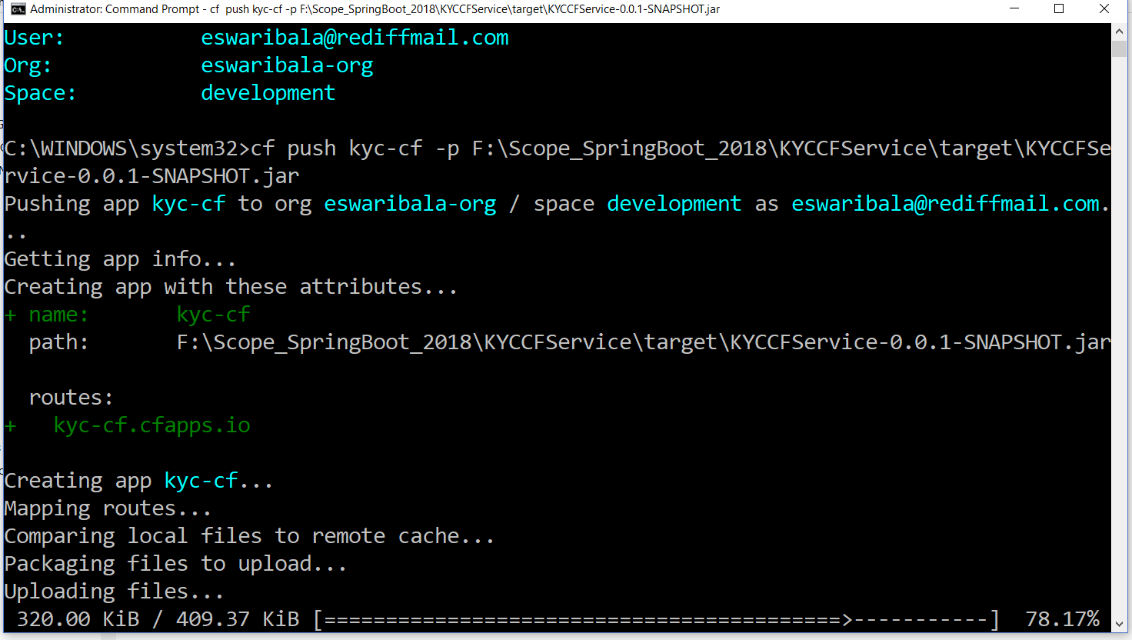
Push Application to Console
cf push kyc-cf -p target\spring-helloworld-cf-0.0.1-SNAPSHOT.jar

Slide 89
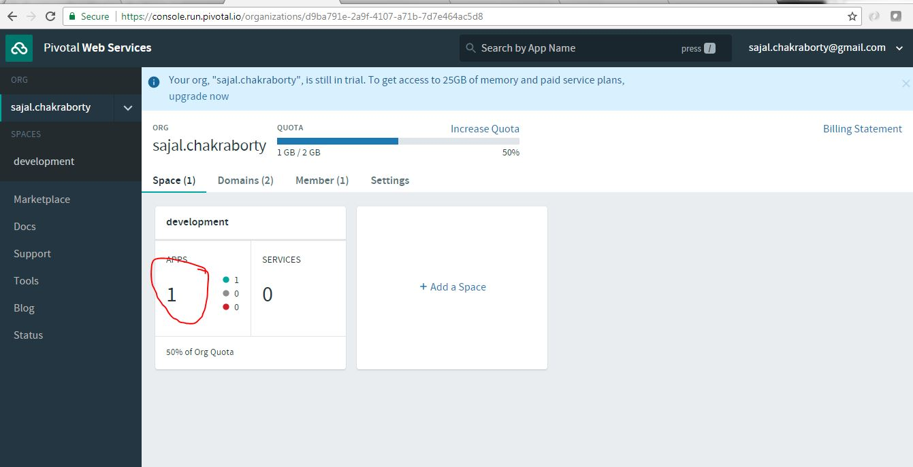
Verify Application Deployed

Slide 90
What is Zuul?
Zuul is the front door for all requests from devices and web sites to the backend of the Netflix streaming application.
As an edge service application, Zuul is built to enable dynamic routing, monitoring, resiliency and security.
It also has the ability to route requests to multiple Amazon Auto Scaling Groups as appropriate.

Slide 91
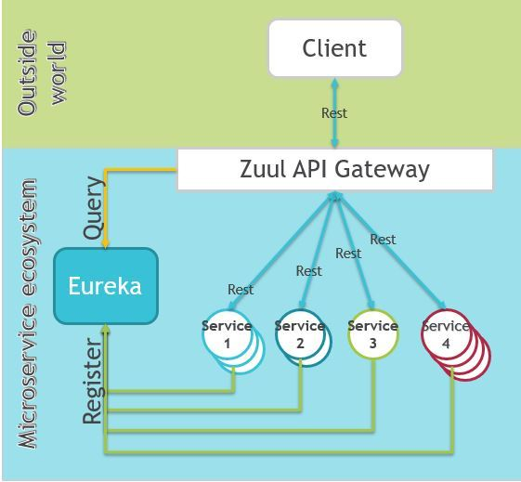
What is Zuul?

Slide 92
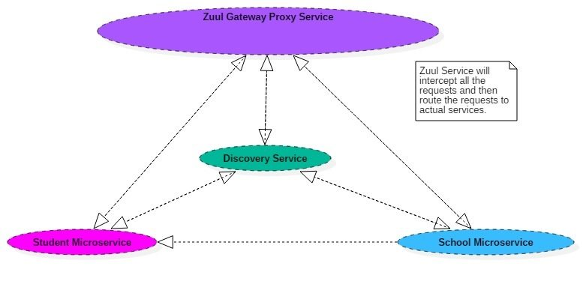
What is Zuul?

Slide 93
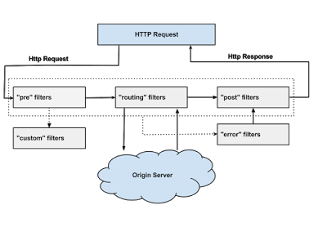

Slide 94
Why did we build Zuul?
The volume and diversity of Netflix API traffic sometimes results in production issues arising quickly and without warning.
We need a system that allows us to rapidly change behaviour in order to react to these situations.

Slide 95
Zuul Components
Zuul has mainly four types of filters that enable us to intercept the traffic in different timeline of the request processing for any particular transaction.
We can add any number of filters for a particular url pattern.
pre filters – are invoked before the request is routed.
post filters – are invoked after the request has been routed.

Slide 96
Zuul Components
route filters – are used to route the request.
error filters – are invoked when an error occurs while handling the request.

Slide 97
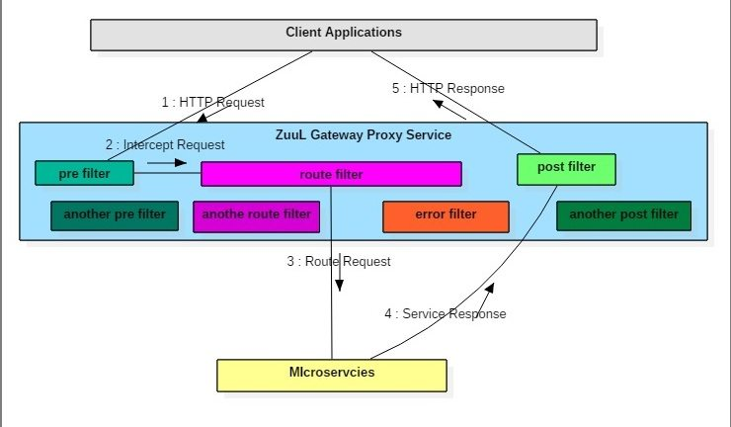
Zuul Components

Slide 98
Zuul Filters Responsibilities
Apply microservice authentication and security in the gateway layer to protect the actual services
We can do microservices insights and monitoring of all the traffic that are going in to the ecosystem by enabling some logging to get meaningful data and statistics at the edge in order to give us an accurate view of production.

Slide 99
Zuul Filters Responsibilities
Dynamic Routing can route requests to different backend clusters as needed.
We can do runtime stress testing by gradually increasing the traffic to a new cluster in order to gauge performance in many scenarios e.g. cluster has new H/W and network setup or that has new version of production code deployed.

Slide 100
Zuul Filters Responsibilities
We can do dynamic load shedding i.e. allocating capacity for each type of request and dropping requests that go over the limit.
We can apply static response handling i.e. building some responses directly at the edge instead of forwarding them to an internal cluster for processing.

Slide 101
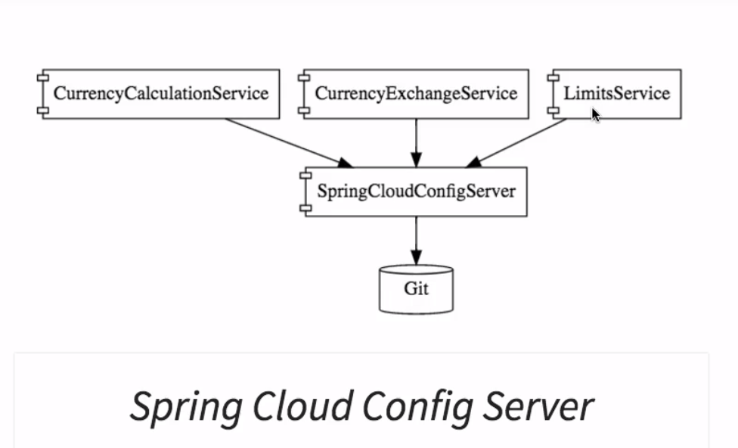
Spring Cloud Config Server with git

Slide 102
Docker
Docker is an excellent tool for managing and deploying microservices.
Each microservice can be further broken down into processes running in separate Docker containers, which can be specified with Dockerfiles and Docker Compose configuration files.
Combined with a provisioning tool such as Kubernetes, each microservice can then be easily deployed, scaled, and collaborated on by a developer team.
Specifying an environment in this way also makes it easy to link microservices together to form a larger application.

Slide 103
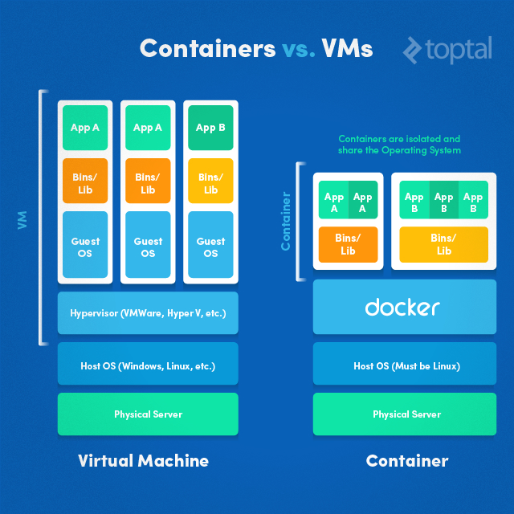
Docker

Slide 104
What is Docker
What is Docker?
At its heart, Docker is software which lets you create an image and then run instances of that image in a container.
Docker maintain a vast repository of images, called the Docker Hub which you can use as starting points or as free storage for your own images.
You can install Docker, choose an image you'd like to use, then run an instance of it in a container.

Slide 105
Difference between VM and Container
Applications running in virtual machines, apart from the hypervisor, require a full instance of the operating system and any supporting libraries.
Containers, on the other hand, share the operating system with the host.
Hypervisor is comparable to the container engine (represented as Docker on the image) in a sense that it manages the lifecycle of the containers.
The important difference is that the processes running inside the containers are just like the native processes on the host, and do not introduce any overheads associated with hypervisor execution.
Additionally, applications can reuse the libraries and share the data between containers.

Slide 106
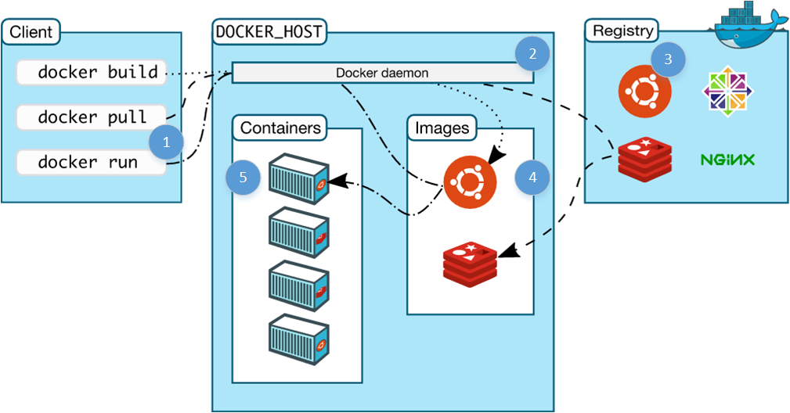
Docker

Slide 107
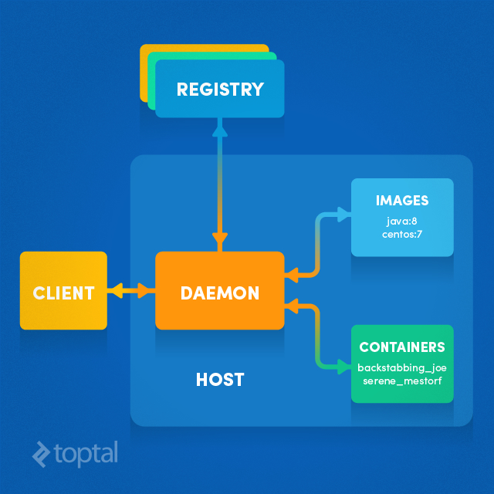
Docker Architecture

Slide 108
Docker Architecture
By default, the main registry is the Docker Hub which hosts public and official images.
Organizations can also host their private registries if they desire.
Images can be downloaded from registries explicitly (docker pull imageName) or implicitly when starting a container. Once the image is downloaded it is cached locally.
Containers are the instances of images - they are the living thing. There could be multiple containers running based on the same image.

Slide 109
Docker Architecture
At the center, there is the Docker daemon responsible for creating, running, and monitoring containers.
It also takes care of building and storing images.
Finally, on the left-hand side there is a Docker client. It talks to the daemon via HTTP.
Unix sockets are used when on the same machine, but remote management is possible via HTTP based API.

Slide 110
Creating Test Database Server
This is a great Docker use case.
We might not want to run our production database in Docker (perhaps we'll just use Amazon RDS for example), but we can spin up a clean MySQL database in no time as a Docker container for development - leaving our development machine clean and keeping everything we do controlled and repeatable.

Slide 111
Creating Test Database Server
docker run --name olddb -e MYSQL_ROOT_PASSWORD=vignesh –e MYSQL_DATABASE=virtusa_2018db –e MYSQL_USER=root -p 3306:3306 mysql/mysql-server:5.5
docker run tells the engine we want to run an image (the image comes at the end, mysql:vlatest
--name db names this container db.
-d detach - i.e. run the container in the background.
-e MYSQL_ROOT_PASSWORD=123 the -e is the flag that tells docker we want to provide an environment variable. The variable following it is what the MySQL image checks for setting the default root password.
-p 3306:3306 tells the engine that we want to map the port 3306 from inside the container to out port 3306.

Slide 112


Slide 113

Creating Test Database Server
Docker ps
docker exec -it olddb /bin/bash
mysql –u root –p

Slide 114
Springboot Docker
<plugin>
<groupId>com.spotify</groupId>
<artifactId>docker-maven-plugin</artifactId>
<version>VERSION GOES HERE</version>
<configuration>
<imageName>example</imageName>
<baseImage>java</baseImage>
<entryPoint>["java", "-jar", "/${project.build.finalName}.jar"]</entryPoint>
<!-- copy the service's jar file from target into the root directory of the image -->
<resources>
<resource>
<targetPath>/</targetPath>
<directory>${project.build.directory}</directory>
<include>${project.build.finalName}.jar</include>
</resource>
</resources>
</configuration>
</plugin>

Slide 115
Springboot Docker
Spring boot Project Build
Goal package docker:build
Docker folder created and docker image name example deployed in docker machine
Check docker images
Docker ps

Slide 116
Springboot Docker
Docker run –t –name sampleapp –link v1db –p 8080:8080 example:latest
Example:latest --- image name
--name – container reference
--link – db ref in container

Slide 117

Spring Cloud Config Server with git

Slide 118

Spring Cloud Config Server with git

Slide 119

Spring Cloud Config Server with git

Slide 120


Spring Cloud Config Server with git

Slide 121

Micro service With Multiple Port

Slide 122

Micro service With Multiple Port

Slide 123

Micro service With Multiple Port

Slide 124

Feign Client

Slide 125

RIBBON LOAD BALANCER

Slide 126
RIBBON LOAD BALANCER
Ribbon is a client-side load balancer, which gives you a lot of control over the behavior of HTTP and TCP clients.
Ribbon's Client component offers a good set of configuration options such as connection timeouts, retries, retry algorithm (exponential, bounded back off) etc.
Ribbon comes built in with a pluggable and customizable Load Balancing component.

Slide 127
RIBBON LOAD BALANCER
Some of the load balancing strategies offered are listed below:
Simple Round Robin LB
Weighted Response Time LB
Zone Aware Round Robin LB
Random LB

Slide 128
RIBBON LOAD BALANCER
Ribbon provides the following features:
Load balancing
Fault tolerance
Multiple protocols (HTTP, TCP, UDP) support in an asynchronous and reactive model
Caching and batching

Slide 129
RIBBON LOAD BALANCER
Bean Type | Bean Name | Class Name
IClientConfig | ribbonClientConfig | DefaultClientConfigImpl
IRule | ribbonRule | ZoneAvoidanceRule
IPing | ribbonPing | DummyPing
ServerList<Server> | ribbonServerList | ConfigurationBasedServerList
ServerListFilter<Server> | ribbonServerListFilter | ZonePreferenceServerListFilter
ILoadBalancer | ribbonLoadBalancer | ZoneAwareLoadBalancer
ServerListUpdater | ribbonServerListUpdater | PollingServerListUpdater

Slide 130
RIBBON LOAD BALANCER
The properties file (sample-client.properties)
# Max number of retries on the same server (excluding the first try)
sample-client.ribbon.MaxAutoRetries=1
# Max number of next servers to retry (excluding the first server)
sample-client.ribbon.MaxAutoRetriesNextServer=1
# Whether all operations can be retried for this client
sample-client.ribbon.OkToRetryOnAllOperations=true
# Interval to refresh the server list from the source
sample-client.ribbon.ServerListRefreshInterval=2000
#

Slide 131
RIBBON LOAD BALANCER
Connect timeout used by Apache HttpClient
sample-client.ribbon.ConnectTimeout=3000
# Read timeout used by Apache HttpClient
sample-client.ribbon.ReadTimeout=3000
# Initial list of servers, can be changed via Archaius dynamic property at runtime
sample-client.ribbon.listOfServers=www.microsoft.com:80,www.yahoo.com:80,www.google.com:80

Slide 132

API Gateway

Slide 133

Zipkin

Slide 134
Questions

Slide 135
Module Summary
Spring Integration Framework.
Message, Channel and Adapter
Understood the different Component Integration
Understood the Event-Driven Architecture

